Slide 1
Neural Network for Wildfire Detection: a hardware design approach
Bachelor Thesis
Constantinos Dionysiou
Cyprus University of Technology
Department of Electrical Engineering

Slide 2
contents
Nonlinear systems
Problem Definition
What is a neural network?
Activation functions
Forward propagation
Backpropagation
Iteration
Refinement
Architecture
Neural Network Topology
Fixed-Point and LUT Activation
Dataset and Sampling
Dataset Examples
Experimental Results

Slide 3
contents
Simulation
Simulation Output
Hardware implementation
FPGA Top-Level Processing Chain
Key RTL Modules
The neuron
Hardware Platforms
End-to-end workflow
VHDL design overview
Resource and Timing
Limitations and Future Work
Conclusion
Bibliography
Technical info

Slide 4
FPGA implementation, neural networks, nonlinear systems
Artificial neural networks (ANNs) are selected for:
adaptability -> analyze diverse data quickly through network parallelism.
FPGAs (field programmable gate arrays) customizable nature:
poorer performance than VLSI (Very Large Scale Integration)
circuits
but possible to change an ANN's features or structure
without rebuilding the circuit.
rapid design cycles and are inherently parallel.

Slide 5
Problem Definition
real-time wildfire indication:
using RGB video streams with per-pixel classification performed at full video frame rate.
The system is designed to operate at the edge, without relying on cloud infrastructure or GPU (Graphical Processing Unit) acceleration.
Goal:
high throughput with low power consumption
reliable and responsive wildfire detection in practical deployments.
Notes:
Clarify that each pixel is classified in real time using FPGA hardware.

Slide 6
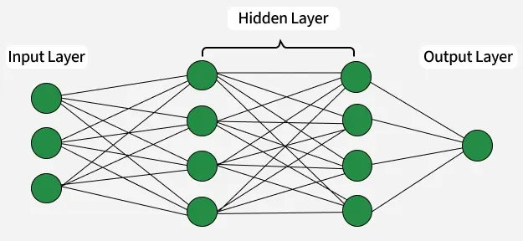
What is neural network?
Neural networks are machine learning models composed of interconnected nodes or neurons that process information, identify patterns, and facilitate tasks such as decision-making and pattern recognition.
Networks are built from several key components:
Neurons: The basic units that receive inputs, each neuron is governed by a threshold and an activation function.
Connections: Links between neurons that carry information, regulated by weights and biases.
Weights and Biases: These parameters determine the strength and influence of connections.
Propagation Functions: Mechanisms that help process and transfer data across layers of neurons.

Slide 7
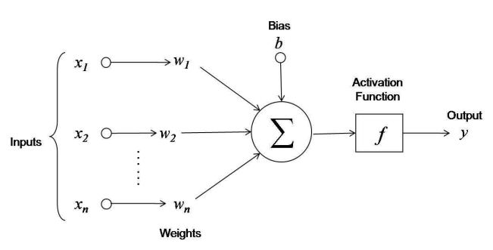
Neuron the output y=f(Xi*Wi+b)
Linear Transformation: Inputs are multiplied by the weights connected to each neuron in a layer. After adding a bias to the total, these products are totaled. This can be expressed numerically as: z=w1​x1​+w2​x2​+…+wn​xn​+b
where
W:represents the weights
X: represents the inputs
b: is the bias

Slide 8
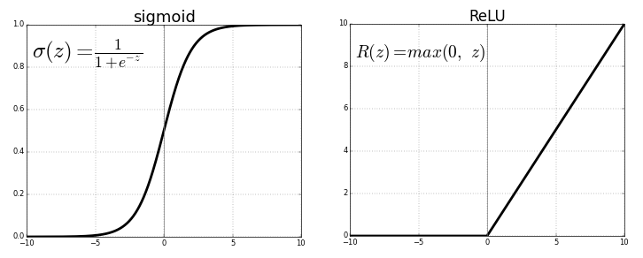
Activation functions
2. Activation: The result of the linear transformation (denoted as z) is then passed through an activation function. The activation function is crucial because it introduces non-linearity into the system, enabling the network to learn more complex patterns. Popular activation functions include ReLU (Rectified Linear Unit) and sigmoid.

Slide 9
forward propagation
Input data is fed into the network, passed through hidden layers, and the output layer generates a prediction.
Calculate output values (e.g., classification probabilities) used for inference
Input: Input data is fed into the input layer
Hidden Layers: Data is passed through hidden layers.
Output Layer: The final layer calculates the prediction

Slide 10
Backpropagation
Following forward propagation:
The network uses a loss function to quantify the discrepancy between:
the actual and expected outputs, assessing its performance.
Reducing this loss is the aim of training.
Loss Calculation: The network determines the loss, which gives an indication of the prediction error.
Gradient Calculation: The network calculates the gradients of the loss function in relation to each network weight and bias.
Weight Update: After the gradients are computed, an optimization procedure such as stochastic gradient descent (SGD) is used to update the weights and biases.

Slide 11
Iteration
Forward propagation, weight updating, backpropagation, and loss computation are all repeated numerous times across the dataset.
This iterative approach gradually lowers the loss and improves the accuracy of the network's predictions.
Neural networks can perform better on tasks like:
classification, regression by adjusting their parameters to accurately represent the relationships in the data.

Slide 12
Refinement
Early wildfire indication directly from a live video stream by performing low-latency, low-power per-pixel classification on an FPGA is targeted. - wildfires cause severe environmental and economic damage - early detection is essential to minimizing their spread.
Compared to cloud-based or GPU-based AI solutions, an FPGA edge implementation can avoid the high latency and power draw that often limit real-time deployment.

Slide 13
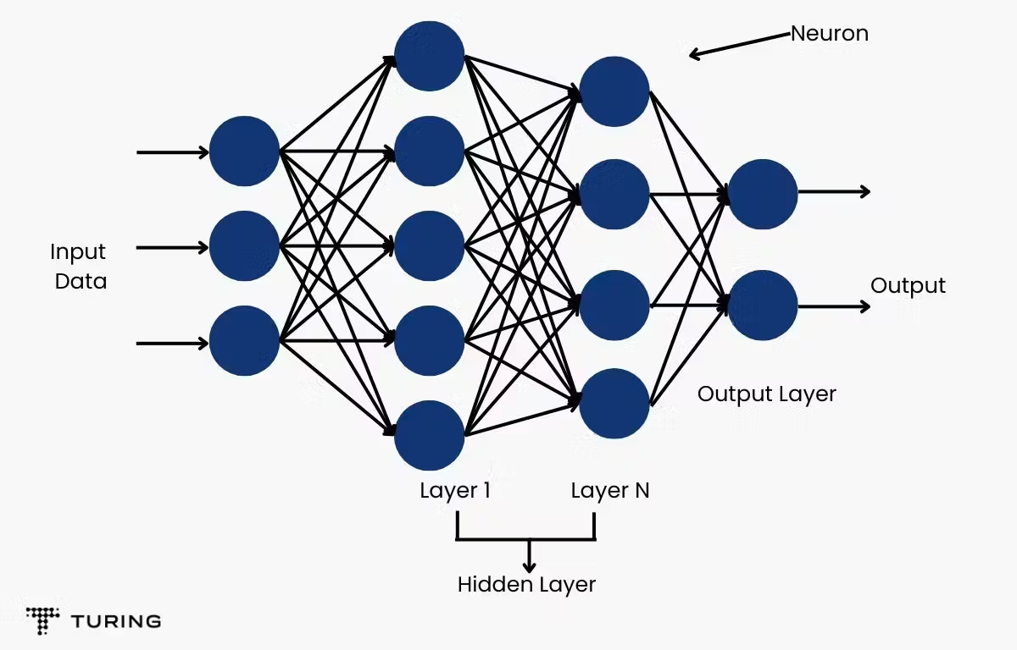
architecture
The architecture used is a 3–7–2 Multi Layer Perceptron (MLP) in Python for training and then in VHDL for inference
class MLP:
def __init__(self, in_dim, hidden, out_dim, act="sigmoid"):
rng = np.random.default_rng(42)
self.W1 = rng.normal(0, 0.2, (hidden, in_dim)).astype(np.float32)
self.b1 = np.zeros((hidden,), dtype=np.float32)
self.W2 = rng.normal(0, 0.2, (out_dim, hidden)).astype(np.float32)
self.b2 = np.zeros((out_dim,), dtype=np.float32)
self.act = sigmoid if act == "sigmoid" else relu
def forward(self, x):
h = self.act(x @ self.W1.T + self.b1)
z = h @ self.W2.T + self.b2
return z, h

Slide 14
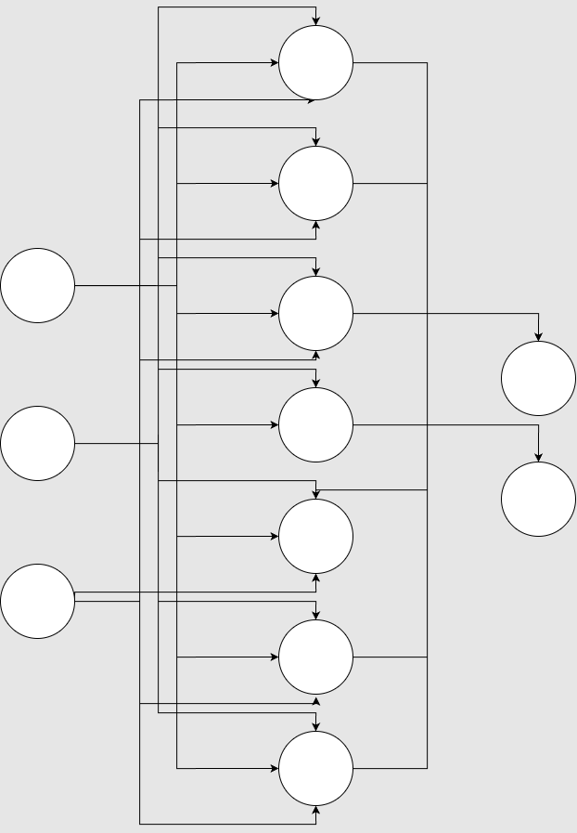
Neural Network Topology and Quantization
Fixed-point design:
- Inputs: 8-bit RGB (0..255) normalized in integer domain
- Weights/bias: signed ints (exported from Python)
- Activation: 12-bit address -> 8-bit output ROM (sigmoid Look Up Table - LUT)
- Total params: 44 ints (3x7 + 7 bias + 7x2 + 2 bias)

Slide 15
Fixed-Point and LUT Activation
Weights/bias quantized to integers, packed in VHDL arrays
Sigmoid implemented as ROM (12-bit address)
Neuron pipeline: parallel multipliers + accumulator + LUT

Slide 16
Dataset and Sampling
Source: wildfire images + segmentation masks (where available)
Per-image random pixel sampling; balanced pos/neg when mask exists
Features: raw RGB (8-bit each); Labels: fire vs not-fire

Slide 17


Dataset Examples
Fire
Not Fire

Slide 18
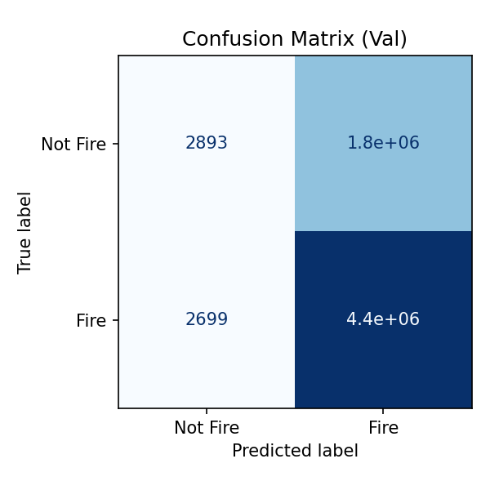
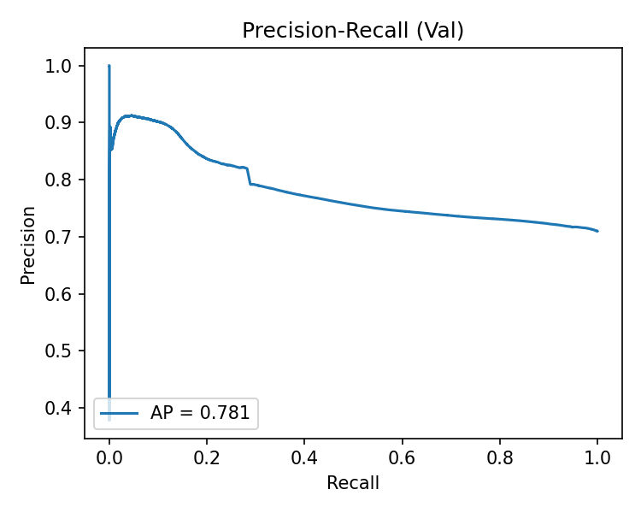
Experimental Results
Software evaluation

Slide 19
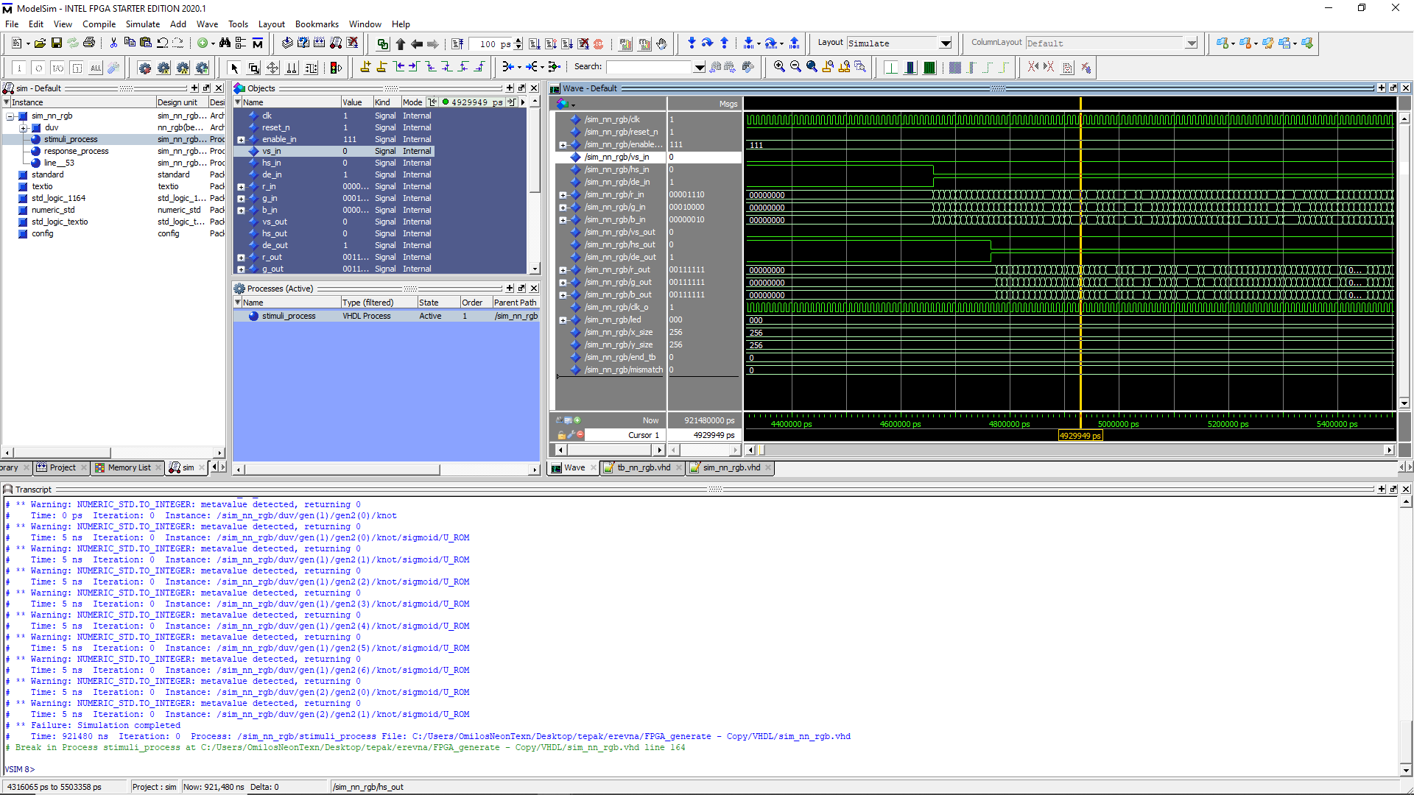
Simulation
Sync/valid signals
clock
RGB input
RGB output
Brake at line 164

Slide 20
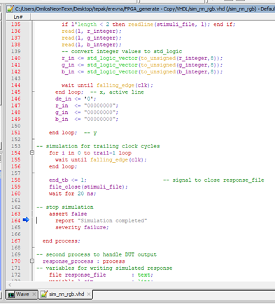
Simulation
Simulation completed
Closing output file as .ppm format

Slide 21

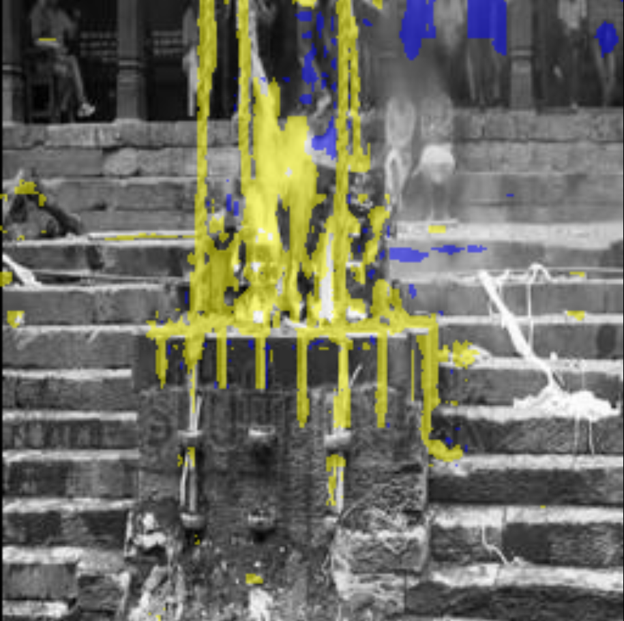
Simulation Output
Offline accuracy on held-out pixels 79.7% (val split 20%)

Slide 22
Hardware implementation
After the training is completed in Python:
The parameters are exported as a table where the values are inserted later as fixed values in VHDL.
The architecture does not change, it is just implemented in hardware.

Slide 23
FPGA Top-Level Processing Chain
Video Rx
PCLK, HS/VS/DE
RGB888
Pre-Scale /
Clamp
MLP 3–7–2
fixed-point
Sigmoid LUT
ROM 4k×8
Classify /
Overlay
Video Tx
Data path: per-pixel inference at pixel clock. One-cycle ROM latency. Pipelined MACs in neuron array.

Slide 24
Key RTL Modules (nn_rgb.vhd)
control.vhd: sync/enable, pipeline alignment
neuron.vhd: MAC tree per neuron with final bias add
multiplier.vhd: per-input multiply (inferred DSP)
sigmoid_IP.vhd: ROM-based LUT (Xilinx BRAM / Intel M9K)

Slide 25
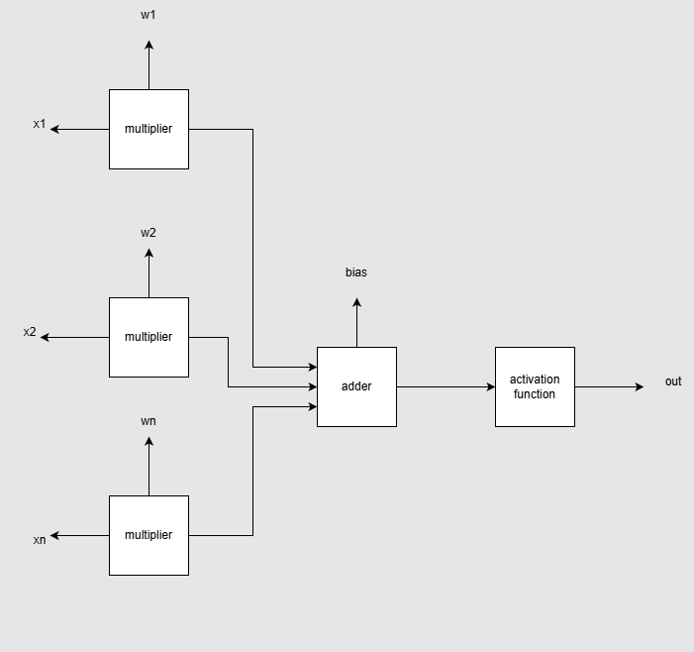
The neuron
The neuron takes the X inputs, multiplies them by the corresponding weights, and then adds them all up, including a bias value.
The output goes into the activation function component, which is created as a ROM.

Slide 26
Hardware Platforms
Xilinx ML501 (Virtex-5): DVI Rx/Tx available, JTAG/SystemACE config
Intel Cyclone V path exists (Quartus 13.0 SP1), no native video Rx
Zynq ultrascale + MPSoCs (only on vivado)
Design is vendor-neutral except sigmoid ROM wrapper

Slide 27
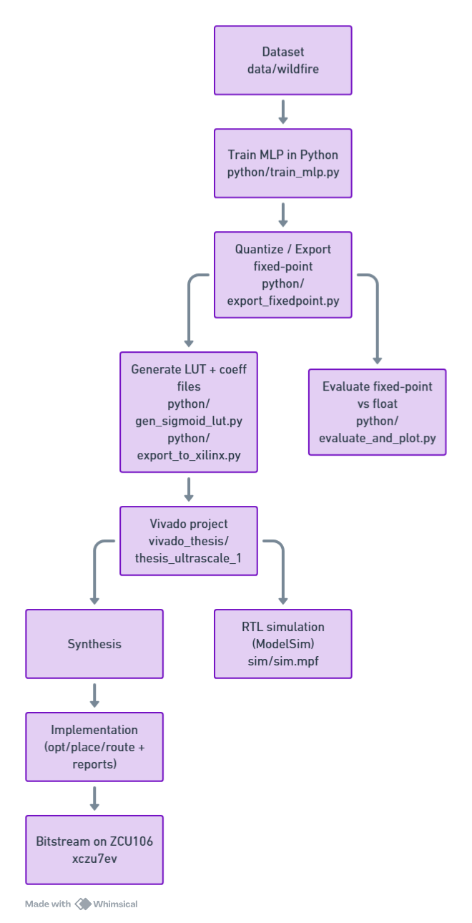
End-to-end workflow
Data and training (Python)
Dataset in wildfire (image and mask folders).
Train MLP and produce floating-point weights/biases using train_mlp.py.
Quantize to fixed-point and export artifacts using:
export_fixedpoint.py: converts trained tensors to fixed-point.
gen_sigmoid_lut.py: generates activation LUT samples.
export_to_xilinx.py: writes COE and optionally a VHDL package.
Config drives sizes/bitwidths via config.yaml.
Outputs:
Fixed-point arrays in artifacts:
weights_layer1.txt, bias_layer1.txt
weights_layer2.txt, bias_layer2.txt
activation_lut.txt

Slide 28
Functional validation (Python)
Using evaluate_and_plot.py we test vectors in testvectors.
RTL simulation (ModelSim/Questa)
Project file sim.mpf compiles the same VHDL sources used by Vivado. It also contains references to stimulus/response images: image_stimuli.ppm, image_response.ppm.
Synthesis and implementation (Vivado 24.1.2, ZCU106)
Python side (how parameters become hardware-initialized constants)
Weights/Biases:
Stored as text files in artifacts. These are typically converted to either a VHDL package with constant arrays or to additional ROM initializations.

Slide 29
VHDL design overview
Source files: VHDL
Top: nn_rgb
Control FSM: control
Compute blocks: neuron, multiplier
Activation: sigmoid_IP, sigmoid_lut
Configuration/constants: config
Simulation/test: sim_nn_rgb, tb_nn_rgb

Slide 30
VHDL design overview
Data path
Pixels (RGB) or features are ingested by nn_rgb.
Layer 1: parallel MACs using multiplier accumulate weighted sums inside neuron, add bias, then apply activation via sigmoid_IP which internally uses a ROM sigmoid_lut .
Layer 2: repeats MAC + activation to produce output probability(ies).

Slide 31
Resource and Timing
Board | f (MHz) | Area (LUT) | Throughput (Gbps) | Throughput/area (Gbps/kLUT) | CLB | Slice
ZCU106 | 74.25 | 4850 | 1.782 | 0.367 | 809 | 809
Spartan 7 | 90.00 | 5060 | 2.184 | 0.432 | 784 | 1568
Artix 7 | 94.00 | 5085 | 2.256 | 0.444 | 791 | 1582

Slide 32
Limitations and Future Work
Training and inference on a single device without software is limited, despite the flexibility and inheritance of parallelism on FPGAs.
The backpropagation modules and data chain can be implemented in terms of area and resource usage.
Even though pattern recognition is effective, more work is required to expand the architecture or add convolution layers.
Decision-making and feature selection might benefit from greater research since more variables can address issues in real time during a wildfire.

Slide 33
Conclusion
This project's goal was to create a VHDL model of an ANN for:
determining the system's functions
The modules' timing behavior and functioning were properly confirmed.
Using FPGA, we take advantage of the high speeds achievable using hardware:
as a result, it is a beneficial and economic investment for designs requiring artificial Neural Networks.
In conclusion, this work demonstrates that low-latency wildfire indication on an FPGA is feasible and efficient.

Slide 34
bibliography
M. A. Alsharif et al., “Deep Learning Approaches for Wildland Fires Using Satellite Remote Sensing Data: Detection, Mapping, and Prediction,” Fire, vol. 6, no. 5, p. 192, 2023. Available: https://www.mdpi.com/2571-6255/6/5/192
A. Filizzola et al., “Wildfire Detection Using Convolutional Neural Networks and PRISMA Hyperspectral Imagery: A Spatial-Spectral Analysis,” Remote Sensing, vol. 15, no. 19, 2023. Available: https://www.mdpi.com/2072-4292/15/19/4855
T. Celik and H. Demirel, “Computer vision based method for real-time fire and flame detection,” Expert Systems with Applications, vol. 36, no. 2, 2009. Available: https://research.itu.edu.tr/en/publications/computer-vision-based-method-for-real-time-fire-and-flame-detecti/
A. Alsharif et al., “AI-based Wildfire Prevention, Detection and Suppression System,” arXiv preprint arXiv:2312.06990, 2023. Available: https://arxiv.org/abs/2312.06990
S. Himavathi, D. Anitha, and A. Muthuramalingam, “FPGA implementation of a multilayer perceptron neural network using VHDL,” in Proc. IEEE, 2007. Available: https://ieeexplore.ieee.org/document/770860
Y. Umuroglu et al., “Accelerating Binarized Neural Networks: Comparison of FPGA, CPU, GPU, and ASIC,” in Proc. IEEE FCCM, 2017. Available: https://ieeexplore.ieee.org/document/7929192
R. Zhao et al., “Accelerating Binarized Convolutional Neural Networks with Software-Programmable FPGAs,” in Proc. ACM/SIGDA FPGA, 2017. Available: https://rzhao01.github.io/publication/bnn_fpga2017/
M. Courbariaux and Y. Bengio, “Binary Networks on FPGAs,” 2016. Available: https://arxiv.org/abs/1602.02830
A. Kumar et al., “Modeling of adaptive artificial neural networks using VHDL,” IJERT, vol. 3, no. 4, 2014. Available: https://www.ijert.org/modeling-of-adaptive-artificial-neural-networks-using-vhdl-is-more-appropriate-using-bipolar-inputs
M. A. Rahman et al., “Hardware implementation of backpropagation neural networks,” 2015. Available: https://www.scirp.org/html/21-1730136_47097.htm
M. H. Hamdan, FPGA Architecture for Deep Learning and Its Application to Planetary Robotics, Iowa State University, 2017. Available: https://lib.dr.iastate.edu/etd/15874/
P. Roth, Digital Systems Design Using VHDL, McGraw-Hill, 2007. Available: https://www.mheducation.com/highered/product/digital-systems-design-using-vhdl-roth/M9780073529540.html
A. A. Khan et al., “Implementation of a feed-forward artificial neural network in VHDL on FPGA,” 2018. Available: https://www.researchgate.net/publication/328370577_Implementation_of_a_feed-forward_Artificial_Neural_Network_in_VHDL_on_FPGA
IEEE, “RT 2020 Conference Proceedings,” 2020. Available: https://ieeexplore.ieee.org/
K. Kara, D. Alistarh, G. Alonso, O. Mutlu, and C. Zhang, “FPGA-accelerated dense linear machine learning: A precision–convergence trade-off,” in Proc. IEEE Int. Symp. Field-Programmable Custom Computing Machines (FCCM), 2017.
Y. Su, K. P. Seng, L. M. Ang, and J. Smith, “Binary Neural Networks in FPGAs: Architectures, Tool Flows and Hardware Comparisons,” Sensors, vol. 23, no. 22, Art. 9254, 2023.
N. M. Botros and M. Abdul-Aziz, “Hardware Implementation of an Artificial Neural Network,” Southern Illinois University, Carbondale, IL, USA.
R. A. Khalil, “Hardware Implementation of Backpropagation Neural Networks on Field Programmable Gate Array (FPGA),” University of Mosul, College of Engineering, Mosul, Iraq.

Slide 35
Technical info
control sequences valid/ready, input loading and layer enable.
config
Purpose: centralizes generics/constants, e.g., number of inputs/neurons/layers, fixed-point width Qm.n, LUT size, address widths.
multiplier
Purpose: fixed-point signed multiply with optional rounding/saturation and a pipeline register to map onto DSP slices in UltraScale+.
Role: building block for MAC inside a neuron.
neuron
Purpose: compute y=σ(∑iwixi+b)y=σ(∑i​wi​xi​+b) in fixed-point.
Internals:
A generate loop of multiplier instances for wi*xi​.
An adder tree/accumulator to sum products.
Bias add, optional saturation, and handoff to activation.
Interfaces: vector input, weight/bias inputs (from constants or ROM), valid/ready or start/done signals.

Slide 36
sigmoid_IP
Purpose: activation function via lookup. Converts fixed-point input to LUT address, reads from BRAM/ROM.
Internals: address scaling/clamping + instance of sigmoid_lut .
sigmoid_lut
Purpose: the ROM primitive or inferred ROM for the LUT samples.
Note: synthesized into BRAM on Zynq UltraScale+
control
Purpose: FSM for sequencing the NN:
Load inputs for layer 1
Start MACs, wait for activation latency
Feed layer 2
Output valid flag and result
Interfaces: clock/reset, input stream (pixels or features), start/valid/ready, and status outputs.

Slide 37
nn_rgb
Purpose: top-level entity; instantiates control + arrays of neurons for each layer + sigmoid IP; wires constants from config; exposes the top I/O.
Role: integration point used as the synthesis top in Vivado TCL scripts.
Testbenches
sim_nn_rgb, tb_nn_rgb read image_stimuli.ppm and compare to image_response.ppm or golden vectors in testvectors.

Slide 38
Data path
Ingress (per clock):
Top entity nn_rgb exposes video ports:
Inputs: vs_in, hs_in, de_in, r_in[7:0], g_in[7:0], b_in[7:0]
Outputs: vs_out, hs_out, de_out, r_out[7:0], g_out[7:0], b_out[7:0]
On each clk, when de_in = '1', the 8‑bit r_in/g_in/b_in samples are registered and forwarded as feature inputs to the first-layer MACs.
Control/timing alignment:
The controller gates “pixel valid” into the compute path and delays vs/hs/de to align with the NN latency, so output timing matches the corresponding processed pixel.

Slide 39
Compute:
Layer MACs multiply each incoming feature by fixed weights using the multiplier, sum inside the neuron, add bias, then apply activation in sigmoid_IP, which reads the LUT ROM sigmoid_lut initialized by coe.
Fixed‑point scaling follows the project’s Qm.n settings from config (inputs are interpreted in that format; arithmetic is scaled by the NN result is mapped to r_out/g_out/b_out (and de_out/hs_out/vs_out are the delayed timing), ready for downstream video.

